Slide 1
Testing Risk Sharing Models
Econ 591
Rachel Heath

Slide 2
Check Bardhan and Udry for some other interesting baseline models
Return to AHM and see how households make decisions if they can smooth ex post
If they can, then risk aversion doesn’t affect production decisions.
But if they cannot perfectly smooth risk ex post, invest suboptimally in risky but productive activities.
Earlier we saw their choice of on farm labor as a special case
Ex ante smoothing. Ideally negative correlation between risk in your productive activities (portfolio choice problem)
Off farm labor (Rose 2001)
Marriage choices (Rosenzweig and Stark 1989)
Migration (Giles 2006; Badiani 2009)
Or at least you want to seek out activities with less risk.
Implicit insurance in labor market (Gutierrez 2014)
Sharecropping

Slide 3
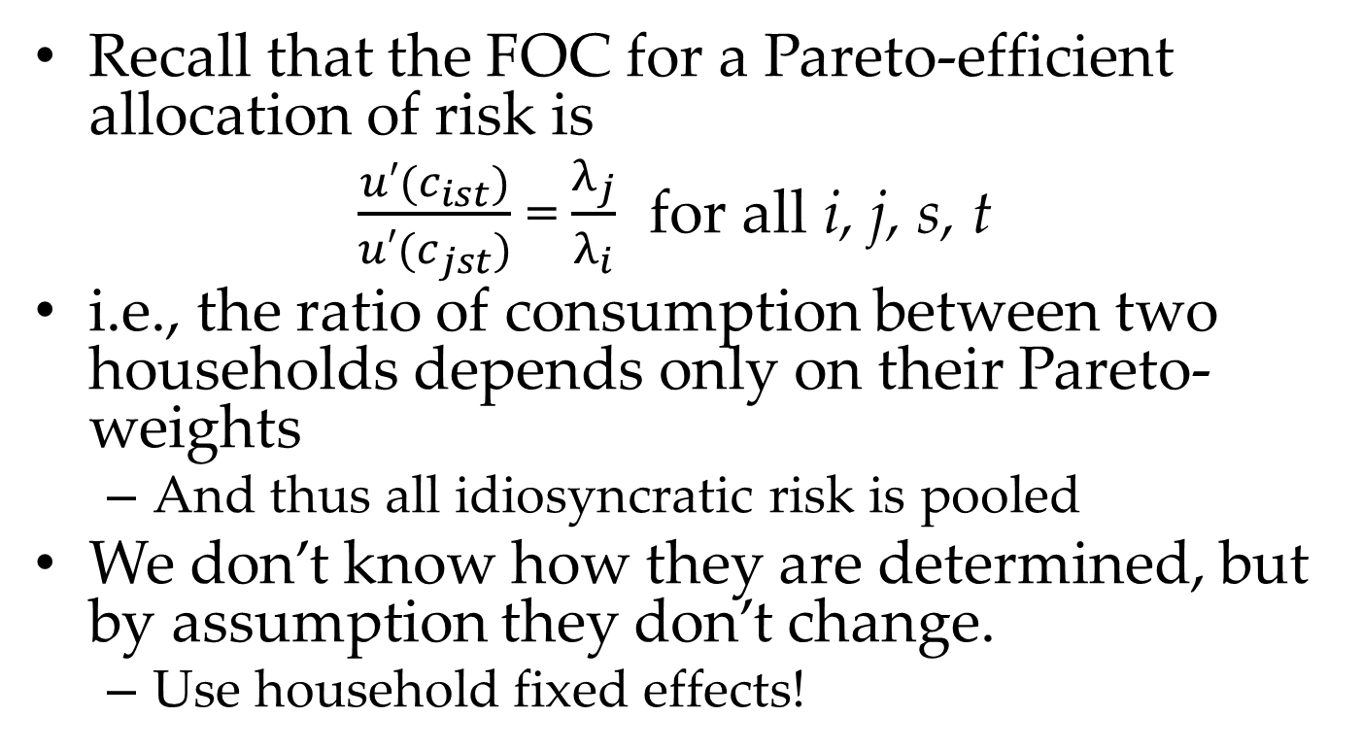
Townsend (1994): test for Pareto-efficient risk pooling in a village
Recall that the FOC for a Pareto-efficient allocation of risk is
$\frac{{u′(c}_{ist})}{u′(c_{jst})}$ = $\frac{λ_{j}}{λ_{i}}$ for all i, j, s, t
i.e., the ratio of consumption between two households depends only on their Pareto-weights
And thus all idiosyncratic risk is pooled
We don’t know how they are determined, but by assumption they don’t change.
Use household fixed effects!

Slide 4
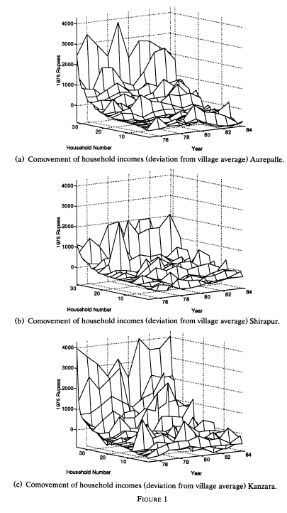
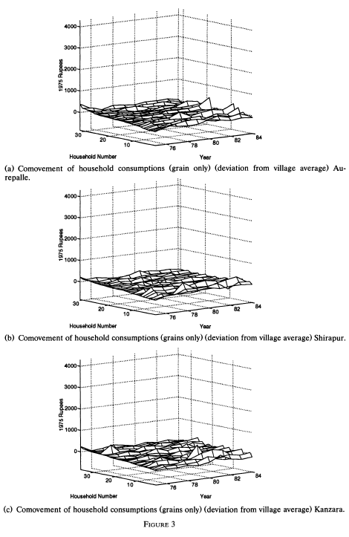
versus
Notes:
Note it’s only grains though!

Slide 5
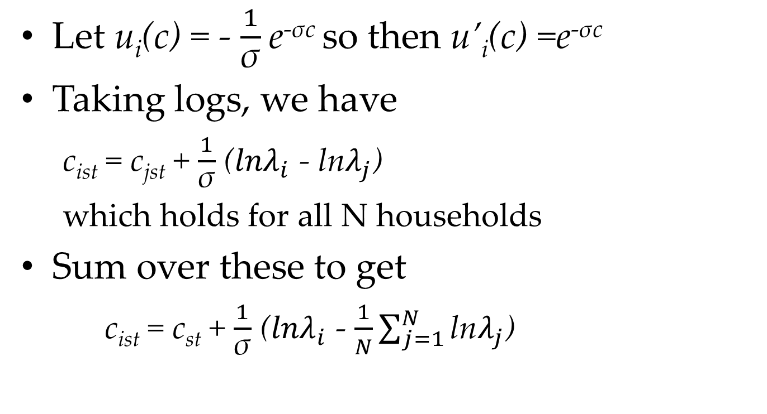
Estimating equation
Let u_{i}(c) = - $\frac{1}{\text{σ}}$e^{-σc} so then u’_{i}(c) =e^{-σc}
Taking logs, we have
c_{ist} = c_{jst} + $\frac{1}{\text{σ}}$ (${lnλ}_{i}$ - ln$λ_{j}$)
which holds for all N households
Sum over these to get
c_{ist} = c_{st} + $\frac{1}{\text{σ}}$ (${lnλ}_{i}$ - $\frac{1}{N}\sum_{j=1}^{N}{\text{ln}λ_{j}}$)

Slide 6
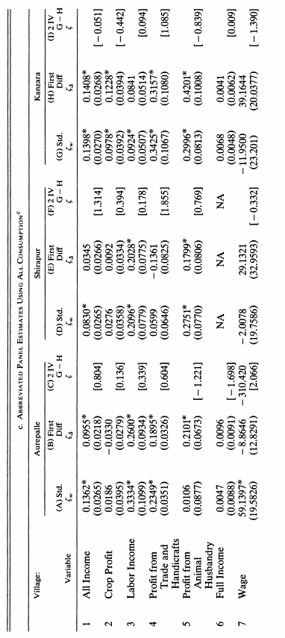
Panel regressions (within village)
c_{it} = α_{i} + βc_{t} + ζX_{it}+ γ*income_{it} + u_{it}
Income matters for consumption… but not very much!

Slide 7



But remember one thing we worry about for a zero result
Measurement error. What if consumption would respond to correctly measured income?
Review classical measurement error. Forget momentarily about the fixed effect and suppose the true model is
But you observe
And you estimate

Slide 8
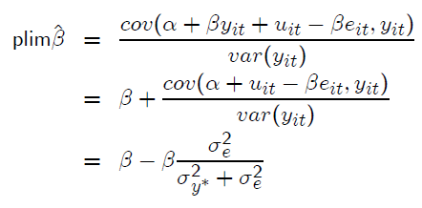
Measurement error biases the estimated coefficient downwards
Signal to noise ratio: the greater is the variance in the measurement error relative to the variance in the true y*, the greater is the downward bias

Slide 9
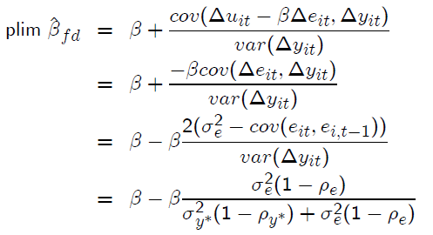



First differencing can exacerbate measurement error
Where we used and
Then as ρ_{y*} approaches 1, the probability limit of β_{FD} approaches 0, no matter the true value!
Notes:
Write the regression using changes, not levels. Similar expression but now relates to serial correlation in ME (relative to correlation in true X), not cross sectional

Slide 10
FE vs FD with measurement error
Can show that β_{FE} still affected by measurement error
And still more so that in cross section if there’s serial correlation in the true outcome…
But less so than the first difference estimator.
Test β_{FE} = β_{FD} to test for measurement error.
Note that if you reject, can construct a weighted average of the two that is consistent (Griliches and Hausman 1986).
Townsend gives us this estimator when he rejects that β_{FE} = β_{FD}
In other cases, people take long-differences to further minimize the role of measurement error.

Slide 11
Conclusions
Rejected full risk-sharing, but still found “a lot” of risk sharing
Consumption fluctuates much less than income
Remember that we have to assume away information and commitment problems in order to sustain a Pareto-efficient equilibrium
Argument can be made that this can happen in a village setting
People know each other well
Agricultural income relatively observable
Ability to sanction households who do not comply
Interact in multiple markets
Mutual acquaintances
Or … is this really about within-household smoothing via saving? Other papers argue that looking at transfers can look more directly at between-household risk sharing (e.g. Foster and Rosenzweig 2001)

Slide 12
Extensions
The next set of risk-sharing papers build asymmetric information into this model.
Moral hazard, with limited commitment (Ligon, Thomas and Worrall 2002 that we’ll see later).
Hidden income (Kinnan 2012)
Risk sharing arrangements can have detrimental impacts
Limit the investment in human capital (Munshi and Rosenzweig 2006 that we’ll see later)
Lower work effort (Jakiela and Ozier, 2012)
Affect migration – theoretically ambiguous whether it would increase or decrease or decrease migration. Morten (forthcoming) finds empirically that risk sharing reduces migration on net – largest cost is leaving risk sharing network at home.
Inefficient if MPL is higher at destination.

Slide 13
Paxson (1992): test the Permanent Income Hypothesis
With complete credit markets, marginal propensity to consume is
One, if the income change is permanent
Very close to zero if the income change in transitory
So if almost all of transitory income is saved, then farmers are using savings to smooth transitory income shocks.
How to identify transient changes in income?
Estimate permanent income, and then transitory income is the residual
Concern: may capture permanent income too if you measure if with error
Paxson: income that can be explained by rainfall fluctuations

Slide 14
A side excursion: using weather variation to estimate transitory income shocks
Monotonicity in an instrumental variable framework: Y_{i} (the outcome) increasing in Z_{i} (the instrument) for all i
Gives us the “LATE” (local average treatment effect) interpretation of an IV (effect of X on Y among those induced to switch by the instrument).
Effects of income shocks on agricultural households…
Whose income is sensitive to rainfall! (e.g. less likely to have invested in irrigation – could be less wealthy/less risk averse)
In this context, monotonicity requires that your measure of a rainfall shock is good for everyone. Floods?
Paxson uses deviation from mean (absolute and squared). So the assumption is indeed that too much rain could be bad.
Notes:
So Paxson’s measure true under assumption that average rainfall = best

Slide 15
So maximizing the theoretical probability of monotonicity is one way to choose instrument
Another criterion: use the measure with strongest first-stage (R-squared or F-stat on joint test of rainfall variables)
Miguel, Satyanath, and Sergenti (JPE 2004) use proportionate change in rainfall from previous year.
Predicts income better than deviations from average and threshhold levels.
Note this suggests some interesting behavioral responses (consistent with habit formation, etc.)
Other times you may not have income at the time of the rainfall shock. For instance
Rainfall shocks during childhood affect adult health (Maccini and Yang 2009)
Rainfall shocks predict sterilization (when the government gives monetary incentives to sterilize). Bharadwaj (2014) uses this as an IV for completed fertility.
In these circumstances, have to make a theoretical argument for relationship between rainfall and income.
Notes:
So Paxson’s measure true under assumption that average rainfall = best. Use understanding from science.

Slide 16
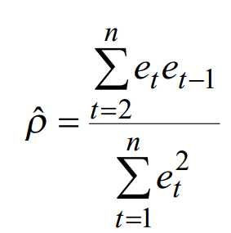
Concern over serial correlation
Temporary shock including trend
Temporary shock without considering trend
If rainfall changes over time, then we are overestimating the actual temporary shock
Some of what we think is transitory is actually permanent
A simple test for serial correlation: is there correlation in residuals between time periods?

Slide 17
Serial correlation in Paxson’s paper
Paxson tests for serial correlation and fails to reject null that rainfall follows white noise process (iid)
If it was, she would have to include rainfall shocks in equation for permanent income
And could only identify temporary income through function form restrictions
Recall that we said this is not ideal

Slide 18
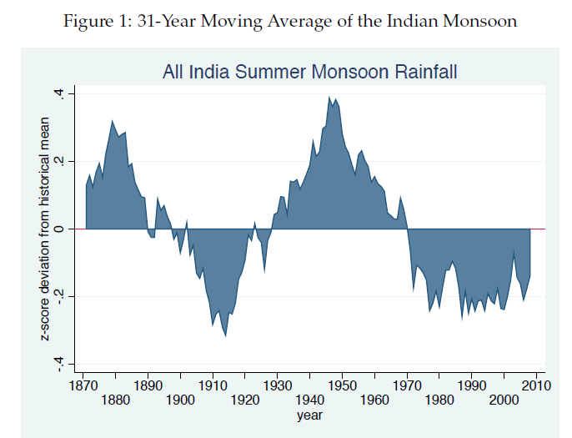
But in other cases, rainfall does actually change over time
Taraz (2013)
She looks for behavioral change of farmers, finds some but little.
In other scenarios, we may be less worried about whether we are capturing permanent or transient income
E.g., comparing Engel curves for sons vs daughters, grains vs protein, etc., etc.
But should still consider whether the income change is temporary or permanent in interpretation
From Taraz (2013)

Slide 19
Measure of savings
Difference between income and expenditure
assumes spending on consumer durables is all consumption
underestimate of savings
Different between income and expenditure on all goods except consumer durables
assumes spending on consumer durables is all savings
overestimate of savings
Purchases minus sales of real and financial assets
also treats spending on consumer durables as consumption
So theoretically the same as (1), but with a different set up measurement issues (capture sales of all assets vs. standard issues with measuring income)
Notes:
Are consumer durables savings? Kinda yes, kinda no. So including them all as savings overestimates savings but including them all as consumptino underestimates

Slide 20
Constructing the estimating equation
Permanent income a function of region FE, land ownership and human capital of household (X^{P}_{irt}) and year FE
Y^{P}_{irt} = β^{P}_{t} + β_{0r} + X^{P}_{irt}β₁ + ε^{P}_{irt}
Transitory income a function of rainfall deviations from average (X^{T}_{rt}) and year FE
note no hh-specific shocks due to lack of data
Y^{T}_{irt} = β^{T}_{t} + X^{T}_{rt}β₂ + ε^{T}_{irt}
Savings a function of permanent and transitory income, income variance, and hh demographics
S_{irt} = α₀ + Y^{P}_{irt} α₁ +Y^{T}_{irt} α₂ +VAR_{ir}α₃ +W_{irt} α₄ + error_{irt}
Reduced form savings equation
S_{irt} = γ_{t} + γ_{r} + X^{P}_{irt} γ₁ +X^{T}_{rt} γ₂ + υ_{irt}
Testable implications of permanent income hypothesis
α₂ = 1 → γ₂ = β₂
α₁ = 0 → elements of X^{p}_{irt} (except those in W_{irt}) should not affect savings → γ₁ = 0 for the landownership variables
Notes:
Write “structural equations”, then rearrange to get the reduced form (with only exogenous variables on the LHS). This is not as common now, but really useful as far as highlighting how to test the theory using exogenous variation.

Slide 21
Constructing the estimating equation
Permanent income a function of region FE, land ownership and human capital of household (X^{P}_{irt}) and year FE
Y^{P}_{irt} = β^{P}_{t} + β_{0r} + X^{P}_{irt}β₁ + ε^{P}_{irt}
Transitory income a function of rainfall deviations from average (X^{T}_{rt}) and year FE
note no hh-specific shocks due to lack of data
Y^{T}_{irt} = β^{T}_{t} + X^{T}_{rt}β₂ + ε^{T}_{irt}
Savings a function of permanent and transitory income, income variance, and hh demographics
S_{irt} = α₀ + Y^{P}_{irt} α₁ +Y^{T}_{irt} α₂ +VAR_{ir}α₃ +W_{irt} α₄ + error_{irt}
Reduced form savings equation
S_{irt} = γ_{t} + γ_{r} + X^{P}_{irt} γ₁ +X^{T}_{rt} γ₂ + υ_{irt}
Testable implications of permanent income hypothesis
α₂ = 1 → γ₂ = β₂
α₁ = 0 → elements of X^{p}_{irt} (except those in W_{irt}) should not affect savings → γ₁ = 0 for the landownership variables
Notes:
Save all transitory income, so effect of rainfall on transitory income the same as effect of rainfall on savings

Slide 22
Constructing the estimating equation
Permanent income a function of region FE, land ownership and human capital of household (X^{P}_{irt}) and year FE
Y^{P}_{irt} = β^{P}_{t} + β_{0r} + X^{P}_{irt}β₁ + ε^{P}_{irt}
Transitory income a function of rainfall deviations from average (X^{T}_{rt}) and year FE
note no hh-specific shocks due to lack of data
Y^{T}_{irt} = β^{T}_{t} + X^{T}_{rt}β₂ + ε^{T}_{irt}
Savings a function of permanent and transitory income, income variance, and hh demographics
S_{irt} = α₀ + Y^{P}_{irt} α₁ +Y^{T}_{irt} α₂ +VAR_{ir}α₃ +W_{irt} α₄ + error_{irt}
Reduced form savings equation
S_{irt} = γ_{t} + γ_{r} + X^{P}_{irt} γ₁ +X^{T}_{rt} γ₂ + υ_{irt}
Testable implications of permanent income hypothesis
α₂ = 1 → γ₂ = β₂
α₁ = 0 → γ₁ = 0 for the landownership variables
Notes:
Don’t save changes to permanent income

Slide 23
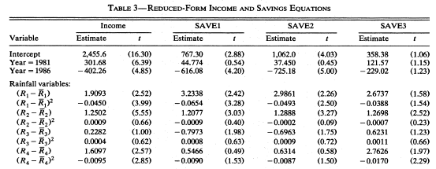
Results
Notes:
Once again, we mainly care about joint tests of significance…

Slide 24
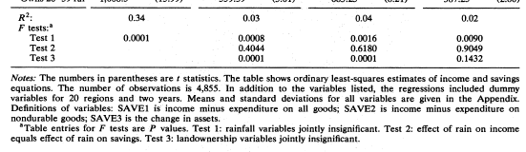
Joint test of significance of rainfall and land ownership variables
Rainfall matters for income
And rainfall matters for savings … cannot reject that effects of rainfall on income the same as effects of rainfall on savings
But landownership variables also predict saving (although coefficients smaller in magnitude)
Transitory income changes do appear to be saved!
Notes:
What really matters is joint test, not individual terms. Landownership shouldn’t predict savings bc should be permanent income. Although extensions (e.g. precautionary savings) reconcile

Slide 25
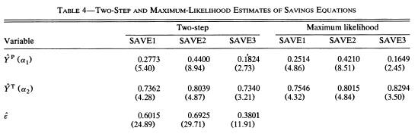
Use the structural model to estimate marginal propensities to consume
As expected, higher marginal propensities to save higher with SAVE2 than SAVE1
Can reject the null that α₁ = α₂
Cannot reject the null that α₂ = 1
Notes:
Again, we’re pretty close to permanent income hypothesis even if not literally there.

Slide 26
Rosenzweig and Wolpin’s critique
How do inputs change in response to weather shocks?
Agricultural profits = income
But data is on revenues, not profits
May have data on some inputs (hired labor, fertilizer, etc.)
But household labor fairly rare

Slide 27



A simplified version of their model
Assume complete factor markets
What is the effect of rainfall variation on farm profits?
Using the envelope theorem,
But we observe
dr
Notes:
Change in profits due to rainfall equal to change in objective function. We observe total derivative, not partial.

Slide 28
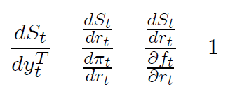
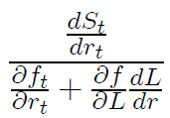

Implications for test of the permanent income hypothesis
Want to test response of savings to transitory income
Numerator observed in data; denominator not. Instead estimating
Sign of bias unclear. It depends on , which is a function of local agricultural technology.
Notes:
Observe how rainfall changes savings. Do not observe partial of savings in response to rainfall. Does how does rain affect marginal product of labor – no strong prior on this

Slide 29
Their overall point
Even when something truly exogenous happens
Rainfall
Lottery numbers
Falling on one side or another of a discontinuity (if there’s no strategic sorting)
People still reoptimize after receiving this shock
Another example: Vietnam lottery as an instrument for labor market experience (Angrist 1990).
Premise: bad lottery number increases the probability of military service, rather than experience.(It’s random unless system rigged. No evidence of this.)
But, what happens when you get a bad lottery number?
Get more education to try to become exempt (control for education. But is it the same quality?)
Employers hesitant to train you?
Migrate to Canada? (Differential selection out of sample)
Cut off your toe?

Slide 30
Munshi and Rosenzweig 2006
Presentation from Azhar

Slide 31
Ligon, Thomas and Worrall
Townsend risk-sharing model assumes every household complies with the social planner
Limited commitment → households have to want to stay in the arrangement
Long term benefits of making a transfer > short term costs
Makes reciprocity credible!

Slide 32
Limited commitment models
Static limited commitment
Coate and Ravallion (1993)
Build in repeated game context
But transfers only depend on state of the world, not history
Transfers look more like gifts than loans (no sense of repayment).
Dynamic limited commitment
Can condition on past history of repayment
Better repayment ability → More ways to keep households in network
Notes:
Static limited commitment: I stay in even if I’m better off deviating today because I know there’s some probability that in a future state I’ll get a transfer. Not because I’ll be repaid for this exact transfer.

Slide 33
Set-up
States of the world s
Income for household i in state s is y_{i}(s)
Income Markov with transition probabilities π_{sr}
Need to impose some structure for tractability
Transition probabilities the same for any date
But allows for serial correlation (realistic and potentially important)
HH’s infinitely lived, risk averse, joint utility maximizers. And no credit transactions with households outside village. Extensions:
Limited commitment within household (Ligon 2006)
Interaction between formal and informal risk-sharing (Mobarak and Rosenzweig 2014)

Slide 34
What is a contract?
τ(h_{t}) specifies a transfer amount between two households, conditional on their history
Penalty for breaching
Exclusion from mutual insurance in the future (subgame perfect Nash equilibrium)
Further loss P_{i}(s) ≥ 0
Shame? Social sanctions?
Can think of as measure of quality of institutions
As P goes to infinity, we get back Townsend model. (Nesting standard model a great feature!)

Slide 35
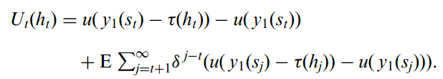
Gain from risk-sharing
Lower immediate utility due to transfer
Here’s where the (potential) repayment comes in
But expectation of higher future utility if risk-averse

Slide 36
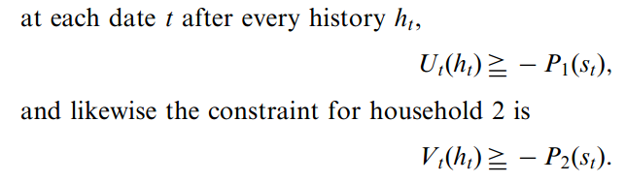
In two household case, sustainable if
Characterize the set of these contracts that are efficient (aka the Pareto frontier)
Write out social planner’s problem: maximize surplus for household 1, conditional on household 2 being willing to participate
Key parameter is Lagrange multiplier on household 2’s utility (λ)
Get range of λ’s that are sustainable.

Slide 37
Notes on sustainable + efficient contracts
P and δ together determine amount of risk sharing
With high enough P, can support any full insurance model (approach Townsend)
But for any P, there is some sustainable insurance contract if households are sufficiently patient
But if P is zero and households are sufficiently myopic, you get back autarky

Slide 38
Testing the model
Assume utility is CRRA
Only need to estimate one parameter (γ)
Gorman aggregability → allows representative agent model (one household vs rest of village)
Know actual consumption from data
For a given set of parameters θ = (γ,δ,P), simulate model to get predicted consumptions and compare to actual
Findings
P finite → reject Townsend model
Also reject static limited commitment model
Don’t do as well at fitting wealthy households (altruism? Foster and Rosenzweig 2001)

